Slide 1



Sodexo
Pilot scope document

Slide 2

01
Agenda
Solution Document
Project Scope
Revenue growth breakdown
Value segment transitions
Product Pricing
Dashboard wireframe
Timelines
2

Slide 3
PROJECT SCOPE
With the available information, Quantzig will explore 3 problem areas as part of the Pilot scope
Business Decisions that can be enabled through available data
Future business use cases (enabled through additional data)
Analytical steps
Business decisions
Revenue growth trends
- Identify revenue trends across stores, customer types and product types
Revenue growth managers will be able to track performance across various cuts to identify growth opportunities
Additional data sources
Historic and future Promotion plans
Data available
Customer ID
Product details
Store details
POS transaction details
Value segmentation transitions
- Define customer segments and engagement levels and revenue movement across them
Enables business to identify growth opportunities across engagement levels
Business use cases
Promotion compliance
Promotion efficiency tracking mechanism
Promotion simulation and optimization
Cannibalization analysis
Product assortment planning
Customer Journey – Next best action study
Directional Pricing model
- Define product, competitor and store features to determine whether a product is underpriced or overpriced
Identify Product-Store combinations where price of the product can be increased
Marketing opportunities
- Market basket analysis and recommendation engine
Create product cross-sell and upsell strategies
Not considered for POC

Slide 4
REVENUE GROWTH BREAKDOWN
Observing the YoY transaction behavior through transaction-tree-diagram gives you an idea of the impact of each segment’s behavior on your business
IDENTIFY THE POINT OF CONCERN IN YOUR BUSINESS
WHAT ARE THE ACTIONABILITY LEVERS?
What is the impact observed in your business?
4%
STORES/OUTLETS
YoY Change in Revenue
Determining the price of products
Determining the menu
Varying Service commission
Can Sodexo charge higher service charge for sale of select products?
Should we focus on customer acquisition or existing customers?
3%
1%
YoY Change from new customers
YoY Change from existing customers
CUSTOMER
Partner with brands to provide lucrative offers to customers
Incentivize customers to use Sodexo cards
Sodexo can target customers with value offers to control customer retention
-2%
3%
What behaviors of your customer groups drove the change?
YoY Change revenue per visit
YoY Change in visits
4%
-6%
QUESTIONS ANSWERED
YoY Change in Variety / number of categories purchased
YoY Change in depth / spend per category
Which customer group can be targeted?
The “ Who”, “What” and “Where” of impact
Considered for POC
PRODUCT PRICING
4

Slide 5
REVENUE GROWTH BREAKDOWN
Observing the YoY transaction behavior through transaction-tree-diagram gives you an idea of the impact of each segment’s behavior on your business
IDENTIFY THE POINT OF CONCERN IN YOUR BUSINESS
AND WHERE IS THE IMPACT OBSERVED?
What is the impact observed in your business?
4%
STORE TYPE
YoY Change in Revenue
-3%
Trolley
2%
Should we focus on customer acquisition or existing customers?
3%
Restaurants
1%
YoY Change from existing customers
YoY Change from new customers
VALUE SEGMENT TRANSITIONS
-4%
HIGH - MEDIUM
-2%
3%
1%
YoY Change revenue per visit
LOW - MEDIUM
What behaviors of your customer groups drove the change?
YoY Change in visits
4%
-6%
QUESTIONS ANSWERED
YoY Change in Variety / number of categories purchased
YoY Change in depth / spend per category
Which customer group can be targeted?
The “ Who”, “What” and “Where” of impact
Considered for POC
PRODUCT PRICING
5

Slide 6
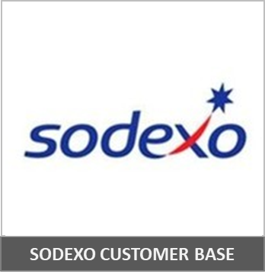



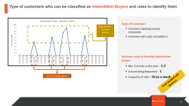
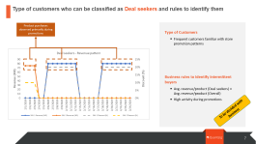
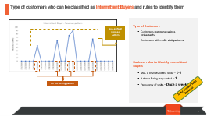
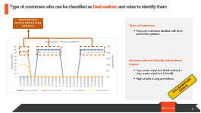
VALUE SEGMENT TRANSITIONS
The first step to tracking the impact of Value segment transitions is to bucket Sodexo’s customers under various engagement levels
CREATION OF CUSTOMER SEGMENTS FROM DATA
ILLUSTRATIVE SAMPLES
Value Per Transaction
Intermittent buyers display an ad hoc purchasing pattern
Quantity per
transaction
Variety of
purchase
Avg. Price of
The Product
Engagement
age
Frequency of
Purchase
Purchase Behavior Patterns
Rule based classification model
Deal seekers display higher activity during promotions
Engagement Levels
LOW | MEDIUM | HIGH
Dormant Customer
Intermittent buyer
Beginners
Potential Churn
Price sensitive buyer
Deal seekers
Product sensitive customers
Specific need customers
Bulk buyers
Most valued customers
Premium product buyers
Loyal customers
CUSTOMER SEGMENTS
6

Slide 7
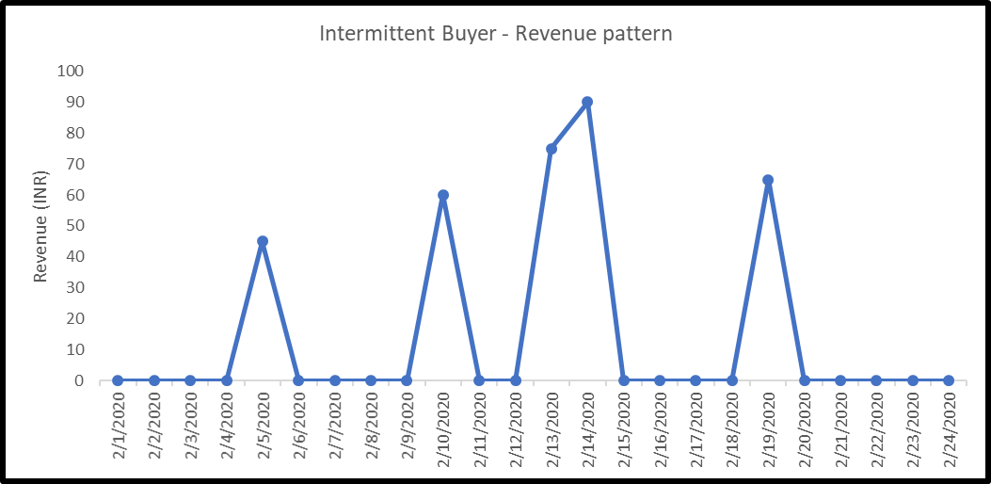
Type of customers who can be classified as Intermittent Buyers and rules to identify them
Type of Customers
Non-uniform revenue
pattern
Customers exploring various restaurants
Customers with cyclic visit patterns
Business rules to identify intermittent
buyers
Min. # of visits to the store – 1-2
# stores being frequented – 1
Frequency of visits – Once a week
Ad hoc buying pattern
To be decided with business
7

Slide 8
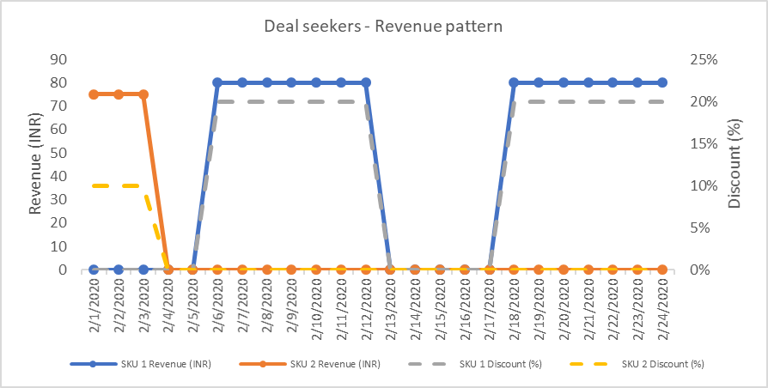
Type of customers who can be classified as Deal seekers and rules to identify them
Product purchases observed primarily during promotions
Type of Customers
Frequent customers familiar with store promotion patterns
Business rules to identify intermittent
buyers
Avg. revenue/product (Deal seekers) < Avg. revenue/product (Overall)
High activity during promotions
To be decided with business
8

Slide 9
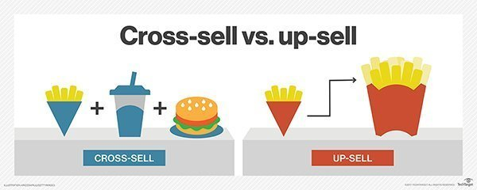
Analyzing the transference of revenue YoY across customer buckets
VALUE SEGMENT TRANSITIONS
Analyzing revenue transference across engagement levels allows us to identify de-growth areas where targeted marketing can help increase revenue
Engagement Levels
NEXT STEPS
LOW | MEDIUM | HIGH
Dormant Customer
Intermittent buyer
Beginners
Potential Churn
Price sensitive buyer
Deal seekers
Product sensitive customers
Specific need customers
Bulk buyers
Most valued customers
Premium product buyers
Loyal customers
Customers with positive growth across Engagement levels can be targeted with Cross Sell and Up sell marketing strategies in order to maximize revenue
CUSTOMER SEGMENTS
To
-4%
1
Change In Revenue
 | LOW | MEDIUM | HIGH
LOW | 2% | 1% | 1%
MEDIUM | -1% | 3% | 1%
HIGH | -1% | -4% | 2%
From
Decline in revenue
Customers with negative movement across Engagement levels should be targeted with retention strategies
2
High valued customer’s transition into Medium value segment led to decline of 4% revenue
KEY DRIVERS OF INTER SEGMENT TRANSITIONS
Right Channel
Right Content
-4%
DTC Calls
Personalized messaging
Right Product
Right Promotion
1%
2%
1%
-3%
-3%
-2%
Historic purchases
High trending products
BOGO Offers
Price discounting
Natural Market Growth
New Product Launch
Impact of Marketing
Pricing
Fulfilment or delivery Issues
Impact of Competition
9

Slide 10

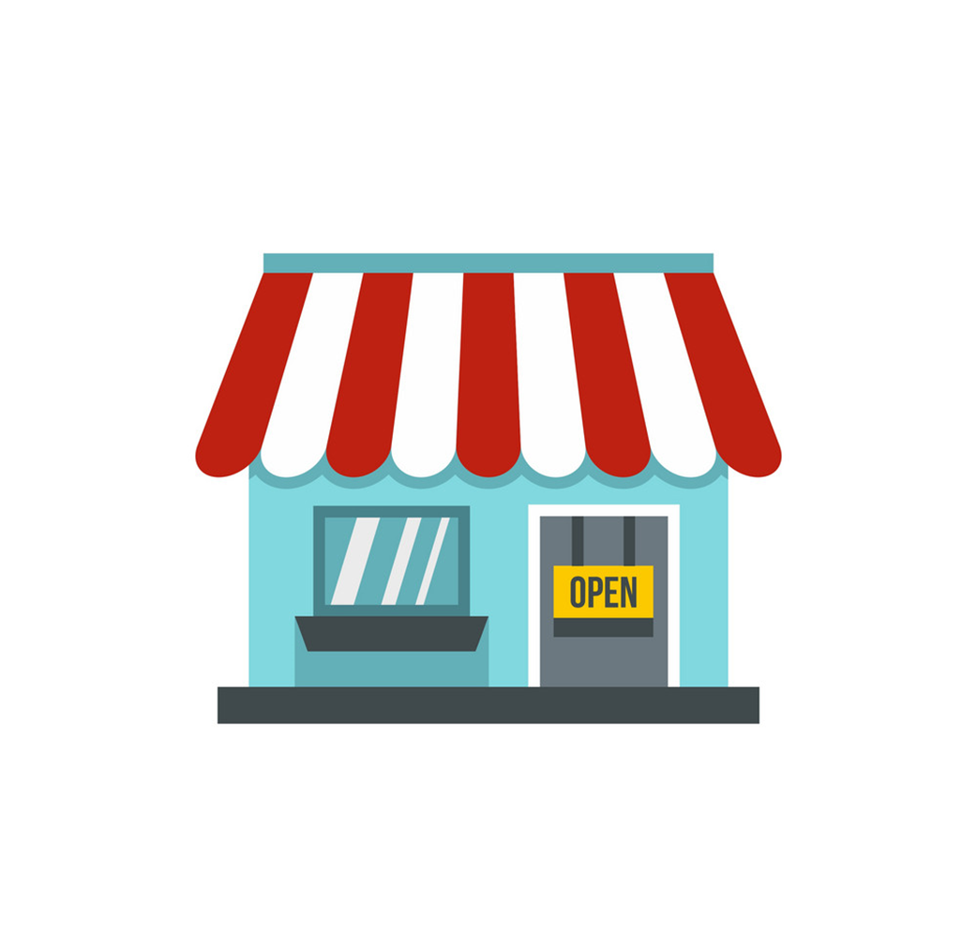
Creating a decision tree based on the features mentioned above
PRODUCT PRICING
Analysing the product, competitor, store and purchase patterns will allow Sodexo to create a directional product-store pricing model
Product details
Competitor details
..attributes/features can be created..
Store details
Purchase patterns
For every product-store combination…
Should the price of the product be adjusted?
..in order to identify which products need price adjustments
Yes
No
Should the price of the product be increased?
Low frequency; high competitive pricing; MRP products
Rule based classification model
Yes - Increased
No - Decreased
High/Increasing demand; Low competition; High willingness to pay
Low/Decreasing demand; high competition pricing; Low willingness to pay
Deterministic price of the product can be identified through a Consumer choice model or via analysis of the Price-Volume relationship of the product

Slide 11
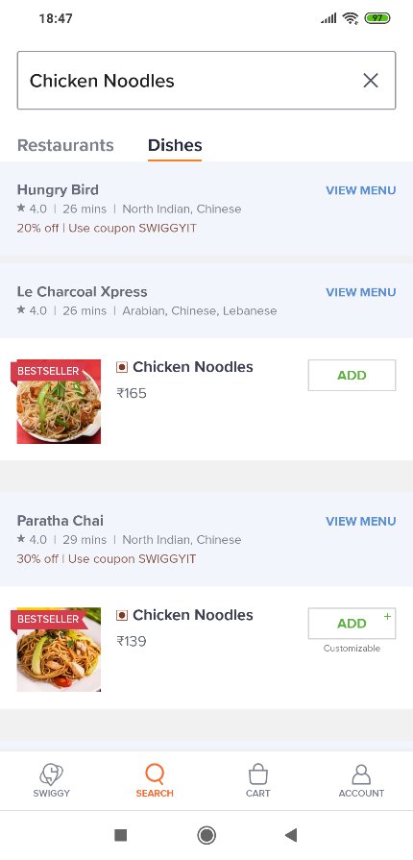

PRODUCT PRICING
Creating cuisine and Store buckets will enable Sodexo to identify pockets in their business where product price can be strategically increased
Data needed
Heuristic clustering of products
Dimension tables
Heuristic clustering of restaurants
Fact tables
Products with high variation in their prices

Slide 12
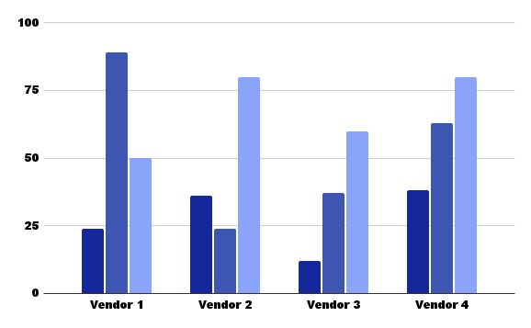
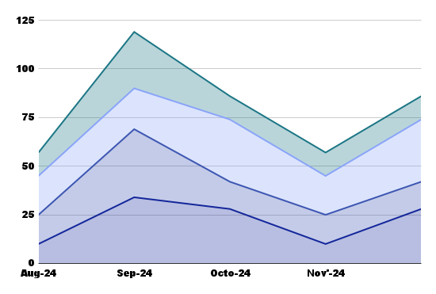
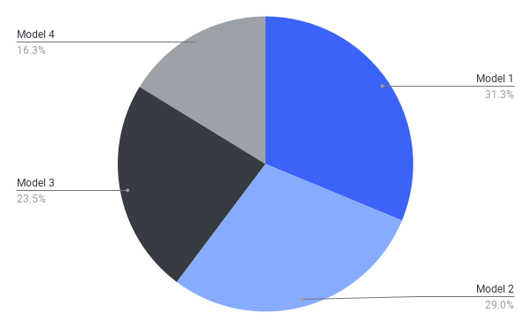
RAG WIREFRAME
Supplier Engagement Strategy
Initiative | Objective
Understanding | Identify key supplier challenges, needs, and expectations through chatbot insights.
Conduct Research | Use chatbot analytics to gather data on supplier interactions and preferences.
Brainstorm Ideas | Generate engagement strategies based on information collected via the chatbot.
Test for Usability | Evaluate the model performance and usability through supplier A/B testing.
RAG Chatbot
Supplier
Year
What will be my total estimated cost for deploying these 3 supplier engagement models?
Category
Model
Supplier Engagement Impact
Turnaround Time
-14%
KPI’s
Turnaround time drop observed primarily after the engagement improved
Could you provide the cost distribution for Vendor 1?
Vendor Performance
On-time delivery percentage
Defect rate
Quality score
Contract adherence
Model wise spends
Supplier Performance
89
On-time delivery
5
Joint
Projects
4 Days
Issue resolution time
Relationship Metrics
Communication frequency
Collaboration index (joint projects)
Satisfaction survey scores
Supplier distribution history

Slide 13
Real-Time LLM-powered KPIs for Instant Supplier Insights
How It Works
The system tracks and aggregates key supplier metrics like on-time delivery, quality, cost reduction, and sustainability performance
LLMs process this data and present it to stakeholders in an easy-to-understand format, with contextual insights tailored to specific performance trends
KPIs are updated in real-time, giving stakeholders immediate access to the latest supplier performance data
Impact on Supplier Engagement: Enhanced Visibility
Stakeholders have up-to-the-minute data on supplier performance, allowing them to take quick actions if necessary.
Informed Decision Making: Real-time access to KPIs makes it easier to engage with suppliers based on data, not assumptions
Identifies performance issues early, enabling stakeholders to engage suppliers before problems worsen.

Slide 14
PROJECT SCOPE
Real-Time LLM-Based KPIs for Suppliers
Business Decisions that can be enabled through available data
Future business use cases (enabled through additional data)
Analytical steps
Business decisions
Revenue growth trends
- Identify revenue trends across stores, customer types and product types
Revenue growth managers will be able to track performance across various cuts to identify growth opportunities
Additional data sources
Historic and future Promotion plans
Data available
Customer ID
Product details
Store details
POS transaction details
Value segmentation transitions
- Define customer segments and engagement levels and revenue movement across them
Enables business to identify growth opportunities across engagement levels
Business use cases
Promotion compliance
Promotion efficiency tracking mechanism
Promotion simulation and optimization
Cannibalization analysis
Product assortment planning
Customer Journey – Next best action study
Directional Pricing model
- Define product, competitor and store features to determine whether a product is underpriced or overpriced
Identify Product-Store combinations where price of the product can be increased
Marketing opportunities
- Market basket analysis and recommendation engine
Create product cross-sell and upsell strategies
Not considered for POC

Slide 15
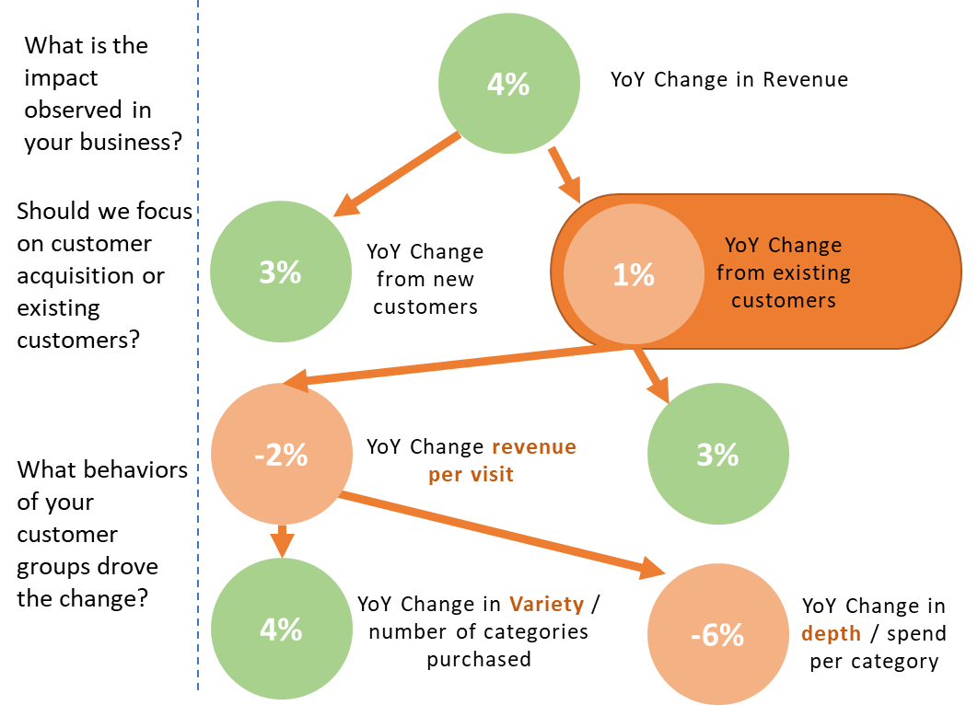
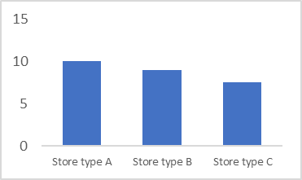
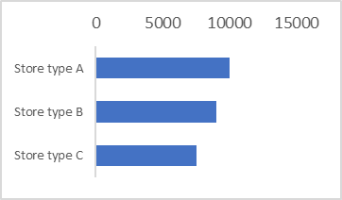
DASHBOARD WIREFRAME
Dashboard wireframe – Executive summary
INR 89K
Weekly sales
-2% WoW
INR 2.3M
YTD sales
4% YoY
Sales performance
Customer type
Year
INR 89K
Weekly sales
-2% WoW
INR 2.3M
YTD sales
4% YoY
Store type
Cuisine type
Business Filters
Revenue growth breakdown
Provides the weekly sales and YTD sales across Sodexo.
Customer type
Store type
Cuisine type
Provides the week over week sales trends, which can further be split across customer types, store types and cuisine types
Revenue growth breakdown
Top and bottom performing store types and cuisine types of the week
Top and bottom performing store types
Top and bottom performing cuisine types

Slide 16
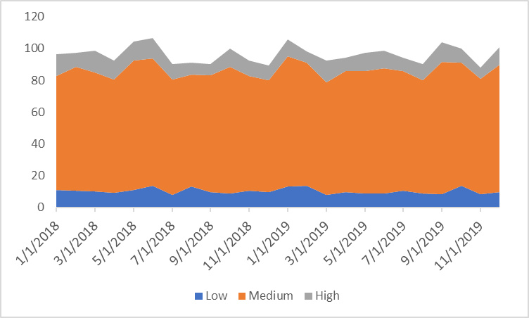
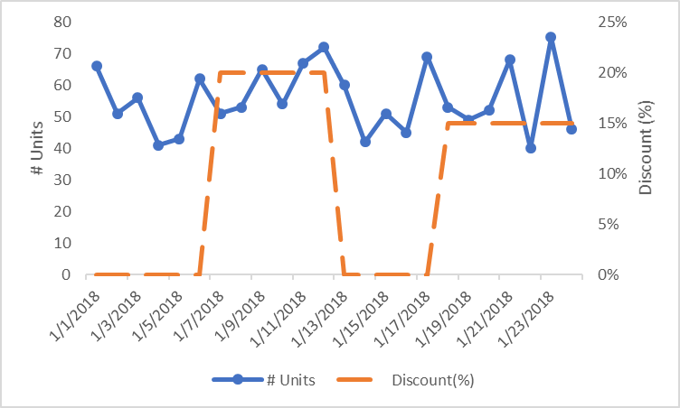
DASHBOARD WIREFRAME
Dashboard wireframe – Value segment transitions and product pricing
Value segment transition
Customer type
Year
Business Filters
INR 82K
Weekly sales
(Existing customers)
-2% WoW
INR 2.1M
YTD sales
(Existing customers)
4% YoY
Store type
Cuisine type
Provides the weekly sales and YTD sales across Sodexo’s Existing customers.
Product pricing
Store Name
Product Name
Provides sales trends across various engagement levels
Price volume trend across time for a store-product combination
Demand transference chart across engagement levels provides a deep dive into revenue variations
 | LOW | MEDIUM | HIGH
LOW | 2% | 1% | 1%
MEDIUM | -1% | 3% | 1%
HIGH | -1% | -4% | 2%
Price Increase
recommended
Directional price recommendations provided for different store-product combinations based on product, competitor, store and purchase patterns
Product details
Competitor details
Store details
Purchase patterns

Slide 17
TIMELINES
Timelines and breakup of tasks for Sodexo
Project Kick-off
Preliminary review with Sodexo
Results sharing & Final review
CALLOUTS
Min. 2 years data would be most ideal for identifying trend and seasonality patterns for the purpose of the POC
Business rules to segment customers and identify price actions will be defined by Quantzig and validated via business through regular touchpoints

Slide 18
Thank You

